Slide 1
Agile Software Development
UNIT II
Extreme Programming

Slide 2
Extreme Programming
Introduction
core XP values
The twelve XP practices
About extreme programming
Planning XP projects
Test first coding
making pair programming work

Slide 3
Extreme Programming (XP)
Originally designed as a way of supporting small development teams working within uncertain and changing requirements.
XP was designed as an approach based on software engineering principles, but focused on the timely delivery of software that meets users’ requirements (rather than on the sometimes over bearing processes that surround the development of software).
An important aspect of XP is the empowerment of the actual developers

Slide 4
XP also places great emphasis on the software development team and teamwork.
The team, in turn, incorporates management, technical personnel and end users all cooperating towards the common good.
It takes as one of its aims that teams communicate and constantly pay attention to all the details necessary to make sure that the software being developed matches the user requirements, to help to produce quality software.

Slide 5
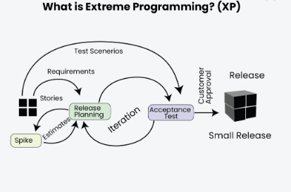

Slide 6
Extreme Programming (XP) is an Agile software development methodology that focuses on delivering high-quality software through frequent and continuous feedback, collaboration, and adaptation. XP emphasizes a close working relationship between the development team, the customer, and stakeholders, with an emphasis on rapid, iterative development and deployment.
Agile development approaches evolved in the 1990s as a reaction to documentation and bureaucracy-based processes, particularly the waterfall approach. Agile approaches are based on some common principles, some of which are:
Working software is the key measure of progress in a project.
For progress in a project, therefore software should be developed and delivered rapidly in small increments.
Even late changes in the requirements should be entertained.
Face-to-face communication is preferred over documentation.
Continuous feedback and involvement of customers are necessary for developing good-quality software.
A simple design that involves and improves with time is a better approach than doing an elaborate design up front for handling all possible scenarios.
The delivery dates are decided by empowered teams of talented individuals.
Extreme programming is one of the most popular and well-known approaches in the family of agile methods. an XP project starts with user stories which are short descriptions of what scenarios the customers and users would like the system to support. Each story is written on a separate card, so they can be flexibly grouped.

Slide 7
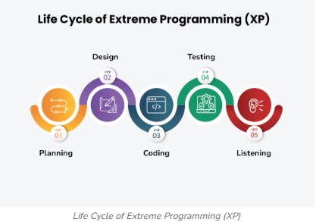

Slide 8
Planning: The first stage of Extreme Programming is planning. During this phase, clients define their needs in concise descriptions known as user stories. The team calculates the effort required for each story and schedules releases according to priority and effort.
Design: The team creates only the essential design needed for current user stories, using a common analogy or story to help everyone understand the overall system architecture and keep the design straightforward and clear.
Coding: Extreme Programming (XP) promotes pair programming i.e. wo developers work together at one workstation, enhancing code quality and knowledge sharing. They write tests before coding to ensure functionality from the start (TDD), and frequently integrate their code into a shared repository with automated tests to catch issues early.

Slide 9
Testing: Extreme Programming (XP) gives more importance to testing that consist of both unit tests and acceptance test. Unit tests, which are automated, check if specific features work correctly. Acceptance tests, conducted by customers, ensure that the overall system meets initial requirements. This continuous testing ensures the software’s quality and alignment with customer needs.
Listening: In the listening phase regular feedback from customers to ensure the product meets their needs and to adapt to any changes.

Slide 10
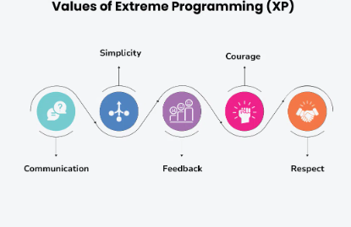
Core XP Values

Slide 11
Communication: The essence of communication is for information and ideas to be exchanged amongst development team members so that everyone has an understanding of the system requirements and goals. Extreme Programming (XP) supports this by allowing open and frequent communication between members of a team.
Simplicity: Keeping things as simple as possible helps reduce complexity and makes it easier to understand and maintain the code.

Slide 12
Feedback: Feedback loops which are constant are among testing as well as customer involvements which helps in detecting problems earlier during development.
Courage: Team members are encouraged to take risks, speak up about problems, and adapt to change without fear of repercussions.
Respect: Every member’s input or opinion is appreciated which promotes a collective way of working among people who are supportive within a certain group.

Slide 13
The twelve XP practices
The planning game- This focuses on planning the next release.
Small releases- A software system is developed iteratively with small releases adding system features and allowing rapid feedback.
Simple design- Keep things as simple as possible but not simpler.
Testing- Unit tests and acceptance tests must be continually developed and the code must pass unit tests for development to continue.
Refactoring- This involves improving the system (e.g., to aid simplicity) without changing the functionality.
Pair programming- All code is developed by developers working in pairs (at a single machine).

Slide 14
Collective ownership- Everyone owns all the code so anyone has the right to change any of the code at any time in order to improve it.
Continuous integration- New code is integrated and the system rebuilt every time a task is completed (which may be many times a day).
On-site customer- Have a real customer as part of the team, so that they are always available to answer questions.
Coding standards - Have them and use them.
40-hour week- Work no more than 40 hours a week so that the developers are always fresh and ready for the challenges facing them.
System metaphor - Use the system metaphor to guide the whole development. It is a metaphor for how the system operates (it is similar to the architecture of the system but typically simpler).
12 Core Practices In Extreme Programming XP🧙‍♂️ (c-sharpcorner.com)

Slide 15
Planning Game
In XP the main planning process is called Planning Game. There are 2 levels of plans in XP; level one is release planning and level 2 is iteration planning.
In both levels, there are 3 steps
exploration
commitment
steering
The first phase is release planning. The team and stakeholders/customers collaboratively decide what are the requirements and features that can be delivered into production and when. This is done based on priorities, capacity, estimations, and risk factors of the team to deliver.
In Iteration planning the team will pick up the most valuable items from the list and break them down into tasks then estimates and a commitment to delivering at the end of the iteration.

Slide 16
Planning XP projects
Planning XP projects –It is a common misconception that XP projects do not need to be planned.
un-convinced because the nature of project planning changes.
It is to decide on the scope and priorities of the project and of the releases.
It is also to estimate the cost of various features required by the software and to schedule those features into releases.

Slide 17
Planning an XP Project
In XP, project planning is a more incremental and inclusive process. It is incremental in that an overall plan of the project is created to determine (roughly) when each release will occur and what will be in that release
Although it is a very different form of planning than that which might be found within a more traditional single delivery style of project.

Slide 18
Then at the start of each iteration, what will be in that iteration or release are determined in detail and an implementation plan for that release is created at that point
There is therefore little chance for the plan and reality to become out of sync.
It also means that if one iteration does go wrong, then the reasons for this can be examined at the start of the next iteration and action taken to avoid this problem in the future

Slide 19
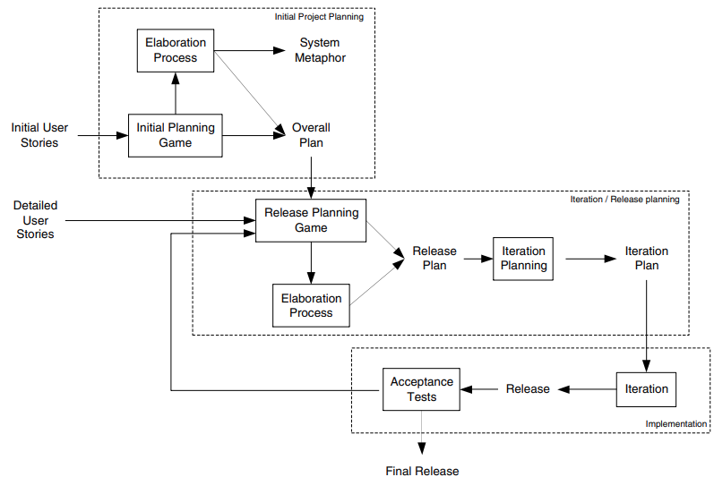
Planning Life cycle

Slide 20
About extreme programming
What is so different, so extreme, about Extreme Programming? The answer lies in a number of places:
Extreme Programming is very lightweight – it really only focuses on the programming of a software system.
Extreme Programming takes the best practices to their ultimate conclusions.

Slide 21
If code reviews are good, then review code all the time (pair programming).
If testing is good, everybody will test all the time (unit testing), even customers (acceptance testing).
If designing is good, then make it part of what everyone does every day (refactoring).
If simplicity is good, then always strive for the simplest effective solution (i.e., the simplest solution that works).
If architecture is important, then ensure that everyone is involved in creating and refining the architecture all the time (system metaphor).
If integration testing is good, then integration and testing should be an on going (daily or even hourly) thing (continuous integration).
If short iterations are good, then make them as short as possible, i.e., hours, or days not weeks and months (the Planning Game).

Slide 22
Pair Programming
For many, pair programming is what they think of when they think of XP. Essentially, two developers working together at one machine, with one keyboard and one mouse, write all software in the system. This is possible because the two developers play different roles: Driver and Navigator
One focuses on the method, class or interface, etc. being implemented (this is the one with the keyboard and the mouse).
The second focuses on the more strategic issues such as how well does this solution fit with the rest of the system, what are its implications, is there a simpler solution, do the tests cover all possibilities, etc.

Slide 23
The pairs that work together are not fixed, even for a particular task. Rather, pairs change as tasks change and as the code being worked on changes.
For example, if you are working on an unfamiliar area of the code, then you might pair with another developer who is more familiar with it. This may change as you move to another area of the code. This may be within a task and thus you may pair with several other developers within a single task. The

Slide 24
Benefits of this include:
Two brains are better than one.
Knowledge of the system is spread amongst the team.
Test coverage may be better as two people will bring two different perspectives with them
Experience is spread amongst the team. If the team is comprised of a mixture of new graduates and developers with ten years experience within the application domain, then by pair programmer, the experienced developers quickly share their understanding of the domain, the technologies and the programming language with the new graduates.
All code is dynamically reviewed by at least one other person who also understands the scenario within which it was developed. This greatly helps to avoid the type of review that ends up focusing on the way the code is laid out rather than the quality of what has been produced

Slide 25
Test first coding
When you have written some code that is to be used by the rest of the project, you should be sure that it works
If anything changes anyone can re-run your unit tests and check that your code still works
When you create your tests first, before the code, you will find it much easier and faster to create your code.
Creating a unit test helps a developer to really consider what needs to be done. Requirements are nailed down firmly by tests

Slide 26
You also have immediate feedback while you work.
There is also a benefit to system design. By creating tests first your design will be influence to test everything to your customer.
There is a rhythm to developing software unit test first.
The code you will create is simple and concise, implementing only the features you wanted.

Slide 27
Making pair programming work
The idea behind pair programming is of course very simple, essentially it comes done to “two heads are better than one”
Pair programming isn’t easy, actually its quite hard.
Knowing how to work in pairs is hard because of different way of working, different way of thinking, it involves inter-personal skills, pair dynamics, communication, tolerance and trust
Every one prefer to be a Driver and the Navigator

Slide 28
Engage in a dialogue.
Listen to each other.
Take frequent breaks.
Make pair programming practical.
Allowing non-pair time
Exploring completing alternative solutions,
Following multiple competing lines of investigation during debugging (but not bug fixing).
Change partners often
{Explanation of the above points in next Page}

Slide 29
Engage in a dialogue. The “driver” should try and explain what they are doing. The “navigator” should ask questions in order to understand what is being done. This is not as simple as it sounds. For example, the next time you are in your car and driving, try telling an imaginary passenger what you are doing, what you are considering and what concerns you have about the road ahead (it helps if the passenger is imaginary so that none of your friends think you are mad!).
Listen to each other. If one member of the pair is doing all the talking then it is probably isn’t working. The one who isn’t saying much might not be clear on what is being done. Try swapping roles, or have a break, or take time out to review where you are.
Take frequent breaks. Pair programming is intensive. It is intensive in terms of the little grey cells and also in terms of inter-personal communications and dynamics. Have regular breaks, talk about other things, see how others are getting on, catch up on the news, etc. Don’t take a break and discuss the code!
Make pair programming practical. Providing enough space to allow a pair to work together comfortably isn’t essential but it can help. This may only go as far as having desks that are big enough for two developers to sit next to each other, or it may involve special double size workstation environments.
Allowing non-pair time. There are some situations where allowing a pair to work alone can be beneficial. This may be a little controversial for some in the XP community, as they will argue that it is always between to work in pairs. However, in the following situations, flying solo may be an alternative (but it should be the rare exception to pair programming):
Exploring completing alternative solutions,
Following multiple competing lines of investigation during debugging (but not bug fixing).
Change partners often. Pairs should not be permanent. Instead, pairs should change as and when required. The typical point at which to change is at the start of a new task. However, if a task ranges over a number of areas, then a “driver” developer may pair with several “navigators” in order to benefit from their different areas of expertise.

Slide 30
NOTES
Extreme Programming was originally designed as a way of supporting small development teams working within uncertain and changing requirements. That is, it was a response to many of the more traditional heavyweight approaches that are often overkill for small software developments. However, it was not an attempt to throw everything away and just program (which is a common misinterpretation of XP). Rather, XP was designed as an approach based on software engineering principles, but focused on the timely delivery of software that meets users’ requirements (rather than on the sometimes over bearing processes that surround the development of software). An important aspect of XP is the empowerment of the actual developers – they should be able to react immediately to changing customer requirements, even late in the development life cycle. XP also places great emphasis on the software development team and teamwork. The team, in turn, incorporates management, technical personnel and end users all cooperating towards the common good. It takes as one of its aims that teams communicate and constantly pay attention to all the details necessary to make sure that the software being developed matches the user requirements, to help to produce quality software.
Underlying XP are four basic principles, these are:
Communication – it is good to talk (particularly, between users and developers).
Simplicity – keep it simple and grow the system as and when required.
Feedback – let users provide feedback early and often.
Courage – to go with such an approach.

Slide 31
Benefits and Setbacks of Pair Programming
As you can imagine there are several benefits to doing pair programming.
Here are some key ones:
Improved code quality
It enables real-time code review and feedback, allowing for early detection of issues, better consistency to coding standards, and higher-quality code overall.
Efficient communication
It encourages constant communication between developers, leading to faster problem-solving, effective coordination, and a shared understanding of project goals and requirements.
Fewer errors and debugging time
With two developers actively involved in writing code, pair programming helps catch errors and bugs early, reducing the time spent on debugging and minimising the chances of releasing faulty software.
More knowledge sharing
By working collaboratively, pair programming promotes the exchange of ideas, techniques, and expertise, allowing developers to learn from each other and improve their skills collectively.
Better job satisfaction

Slide 32
Benefits and Setbacks of Pair Programming
It can help make work more enjoyable, as well as promote teamwork, and provide opportunities for continuous learning and growth. This leads to increased job satisfaction among developers as you’ll feel more engaged and supported in your work.
However, it may not be all fun and sunshine, there are some setbacks and disadvantages that can also come with pair programming, such as:
Reduced productivity
Pair programming can sometimes result in slower progress as two developers are working on the same task simultaneously, leading to a potential decrease in overall productivity.
Clash of personalities
Conflicting work styles, communication preferences, or personal differences between developers may lead to tension or disagreements that hinder effective collaboration.
Increased fatigue
Working in pairs for extended periods can be mentally and physically exhausting, potentially resulting in fatigue and reduced concentration, which may impact the quality of work produced.
Unequal work contributions
There is a possibility of one developer dominating the pairing session, leading to an imbalance in work contributions, where one person is more engaged in the coding while the other takes a passive role, resulting in an uneven distribution of effort.
Higher costs for companies
Pair programming requires two developers to work together, which can increase costs for companies, as they need to allocate resources accordingly, potentially reducing the number of tasks that can be worked on simultaneously.
Whilst some of these benefits and setbacks are specifically related to working as a developer within a company, many of them still apply to pairing in general so useful to know even if you’re still learning.

Slide 33
There are no hard and fast rules to how to do this, there are things that can help in pair programming
Engage in a dialogue. The “driver” should try and explain what they are doing. The “navigator” should ask questions in order to understand what is being done. This is not as simple as it sounds. For example, the next time you are in your car and driving, try telling an imaginary passenger what you are doing, what you are considering and what concerns you have about the road ahead (it helps if the passenger is imaginary so that none of your friends think you are mad!).
Listen to each other. If one member of the pair is doing all the talking then it is probably isn’t working. The one who isn’t saying much might not be clear on what is being done. Try swapping roles, or have a break, or take time out to review where you are.
Take frequent breaks. Pair programming is intensive. It is intensive in terms of the little grey cells and also in terms of inter-personal communications and dynamics. Have regular breaks, talk about other things, see how others are getting on, catch up on the news, etc. Don’t take a break and discuss the code!
Make pair programming practical. Providing enough space to allow a pair to work together comfortably isn’t essential but it can help. This may only go as far as having desks that are big enough for two developers to sit next to each other, or it may involve special double size workstation environments.
Allowing non-pair time. There are some situations where allowing a pair to work alone can be beneficial. This may be a little controversial for some in the XP community, as they will argue that it is always between to work in pairs. However, in the following situations, flying solo may be an alternative (but it should be the rare exception to pair programming):
Exploring completing alternative solutions,
Following multiple competing lines of investigation during debugging (but not bug fixing).
Change partners often. Pairs should not be permanent. Instead, pairs should change as and when required. The typical point at which to change is at the start of a new task. However, if a task ranges over a number of areas, then a “driver” developer may pair with several “navigators” in order to benefit from their different areas of expertise.

Slide 34
Reference Links
XP Intro,Life cycle,XP values
What is Extreme Programming (XP)? - GeeksforGeeks
XP Practices
12 Core Practices In Extreme Programming XP🧙‍♂️ (c-sharpcorner.com)
Benefits and set backs of pair programming
👥 The Ultimate Guide to Effective Pair Programming (evergrowingdev.com)
Test first coding
Test First (extremeprogramming.org)
How to Get The Most Out of Pair Programming
How to Get The Most Out of Pair Programming | 8base Blog

Slide 35
Assignment
1.Write a brief note on “Planning XP Projects”
2.Describe about Extreme Programming (XP). Explain FOUR Core XP Values?
3.Explain Twelve XP Practices for agile continuum with suitable examples.
4.What strategies can teams employ to ensure effective pair
programming in an XP environment, especially when dealing with differences in skill levels or personalities?

Slide 36
Assignment
1.Write a brief note on “Planning XP Projects”
2.Describe about Extreme Programming (XP). Explain FOUR Core XP Values?
3.Explain Twelve XP Practices for agile continuum with suitable examples.
4.What strategies can teams employ to ensure effective pair
programming in an XP environment, especially when dealing with differences in skill levels or personalities?

